Slide 1
British Airways CustomeR Satisfaction Analysis
Interactive Tableau Dashboard for Customer Experience & Operational Insights
Challa Harika
DA/BA Batch
Tools Used: Tableau, Excel, Power Query, Data Modeling

Slide 2
Business Problem:
British Airways receives thousands of customer reviews from passengers worldwide. However, management needs answers to questions like:
How satisfied are customers?
Which services need improvement?
Which routes perform well?
Which aircraft provide better experiences?
Which customer segments are most satisfied?
Objective: Build an interactive Tableau dashboard to monitor customer satisfaction and support data-driven operational decisions.
Dataset Overview:
Dataset | Description
ba_reviews | Customer review details
countries | Country and Region Mapping
Important Columns : Overall Rating, Cabin Staff Rating, Seat Comfort Rating, Food Rating, Entertainment Rating, Ground Service Rating
Average Value for Money, Traveller Type, Seat Type, Aircraft, Route, Date Flown, Recommended, Country
Total Reviews: 1295
Time Period: 2015–2023

Slide 3
Data Preparation
Data Cleaning:
Removed missing values.
Corrected datatype mismatch between columns
Created relationships between tables
Verified data quality
Created Calculated Fields:
Overall Rating
Cabin Staff Rating
Seat Comfort Rating
Food Rating
Entertainment Rating
Ground Service Rating
Average Value for Money
Recommendation Rating
Total Reviews
Review count
Workflow Diagram:
Raw Data
↓
Data Cleaning
↓
Data Modeling
↓
Calculated Fields
↓
Worksheets
↓
Dashboards

Slide 4
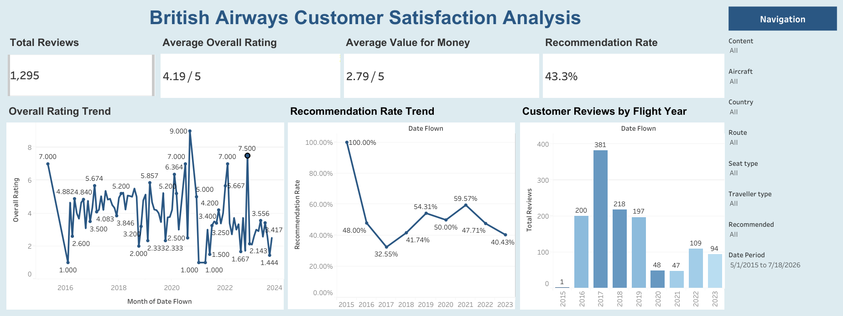
Executive Overview Dashboard

Slide 5
Executive Overview Dashboard Insights
How is British Airways performing overall?
KPIs:
Total Reviews : 1,295
Average Overall Rating : 4.19/5
Recommendation Rate : 43.3%
Average Value for Money : 2.79/5
Overall Rating Trend : Customer satisfaction fluctuates over time rather than improving consistently.
Recommendation Trend : Recommendation peaked around 2021 before declining again, suggesting customer loyalty is unstable.
Customer Reviews by Flight Year : Most reviews were received during 2017–2019.
Business interpretation:
Larger review volume provides stronger confidence in those years' insights.
Recent years have fewer reviews, so conclusions should be interpreted carefully.
Executive Insight:
Overall ratings are relatively good, but recommendation rate is below 50%, indicating customers may be satisfied with some aspects of the flight but are still reluctant to recommend British Airways. The KPI card shows the overall recommendation rate of 43.3%, meaning fewer than half of all reviewers recommended British Airways. The line chart breaks this down by year. While 2015 shows a 100% recommendation rate, that year had only one review, so it isn't representative. From 2016 onward, recommendation rates generally range between 30% and 60%, indicating that customer advocacy has remained inconsistent over time.

Slide 6
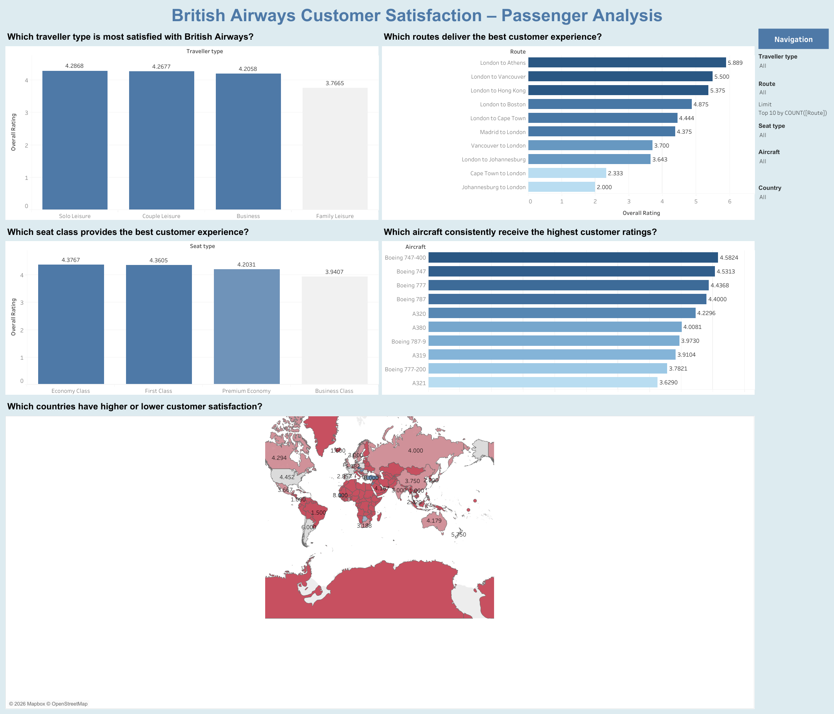
Passenger Analysis Dashboard

Slide 7
Passenger Analysis Dashboard Insights
1. Which traveller type is most satisfied with British Airways?
A. Solo Leisure travellers reported the highest average overall rating (4.29/5), closely followed by Couple Leisure (4.27/5) and Business travellers (4.21/5). Family Leisure travellers recorded the lowest satisfaction (3.77/5), indicating opportunities to improve the travel experience for families.
2. Which routes deliver the best customer experience?
A. London to Athens (5.89/5), London to Vancouver (5.50/5), and London to Hong Kong (5.38/5) received the highest customer ratings, suggesting these routes consistently deliver a better passenger experience. In contrast, Johannesburg to London (2.00/5) and Cape Town to London (2.33/5) received comparatively lower ratings and may require further operational review.
3. Which seat class provides the best customer experience?
Economy Class (4.38/5) and First Class (4.36/5) received the highest overall ratings, while Business Class (3.94/5) recorded the lowest customer satisfaction among the four seat types. This suggests that the premium Business Class experience may not be meeting passenger expectations relative to its offering.
4. Which aircraft consistently receive the highest customer ratings?
The Boeing 747-400 (4.58/5) received the highest average customer rating, followed by the Boeing 747 (4.53/5) and Boeing 777 (4.44/5). These aircraft demonstrate consistently strong customer satisfaction and can serve as benchmarks for service quality across the fleet.
5. Which countries have higher or lower customer satisfaction?
A. Customer satisfaction varies across countries, highlighting regional differences in passenger experience. This geographic analysis enables British Airways to identify markets with stronger customer satisfaction while prioritizing improvement initiatives in lower-performing regions.

Slide 8
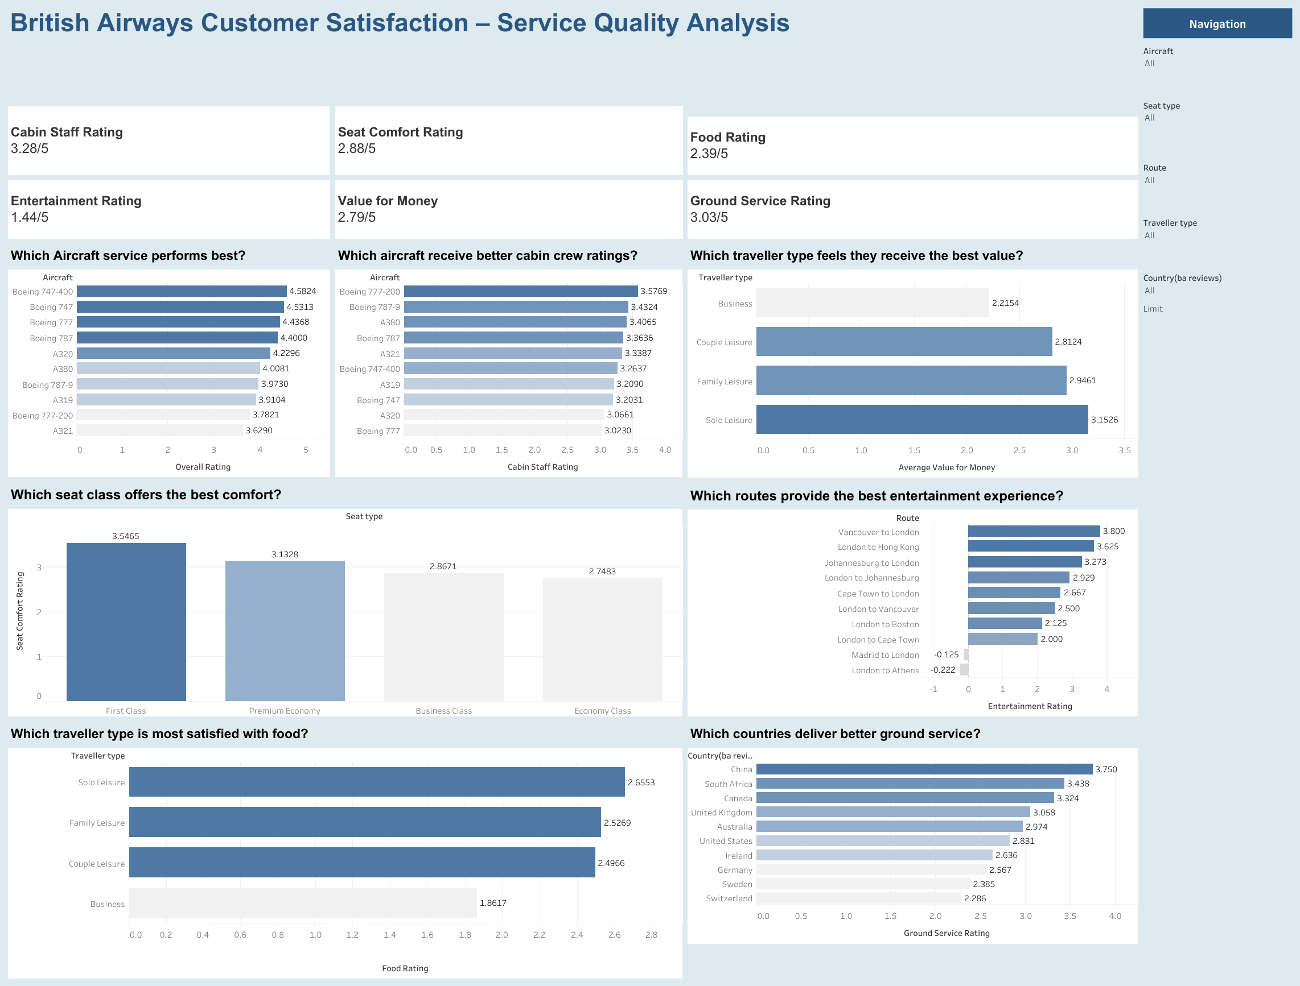
Service Quality Analysis Dashboard

Slide 9
Service Quality Analysis Dashboard Insights
Which service areas influence customer satisfaction the most?
KPI cards:
Cabin Staff: 3.28
Seat Comfort: 2.88
Food: 2.39
Entertainment: 1.44
Value for Money: 2.79
Ground Service: 3.03
Entertainment received the lowest customer rating and appears to be the weakest service area.
Business Questions and Insights
1. Which Aircraft Service Performs Best ?
A. The Boeing 747-400 achieved the highest overall service rating (4.58/5), followed by the Boeing 747 (4.53/5) and Boeing 777 (4.44/5). These aircraft consistently deliver a superior customer experience and can serve as operational benchmarks for the rest of the fleet.
2. Which Aircraft Receive better cabin crew ratings ?
A. The Boeing 777-200 received the highest average Cabin Staff Rating (3.58/5), followed by the Boeing 787-9 (3.43/5) and Airbus A380 (3.41/5). This suggests passengers perceive cabin crew service to be strongest on these aircraft.
3. Which Traveller Type Feels They Receive the Best Value?
A. Solo Leisure travellers reported the highest Value for Money rating (3.15/5), followed by Family Leisure (2.95/5) and Couple Leisure (2.81/5). Business travellers gave the lowest value rating (2.22/5), indicating that premium travellers perceive less value from the services received.

Slide 10
4. Which Seat Class Offers the Best Comfort?
A. First Class received the highest Seat Comfort Rating (3.55/5), followed by Premium Economy (3.13/5). Business Class (2.87/5) and Economy Class (2.75/5) received comparatively lower comfort ratings, suggesting opportunities to improve seating comfort outside First Class.
5. Which Routes Provide the Best Entertainment Experience?
A. Vancouver to London achieved the highest Entertainment Rating (3.80/5), followed by London to Hong Kong (3.63/5) and Johannesburg to London (3.27/5). Conversely, London to Athens (-0.22) and Madrid to London (-0.13) received the lowest entertainment scores in the dataset and may require further investigation.
6. Which Traveller Type Is Most Satisfied with Food?
A. Solo Leisure travellers reported the highest Food Rating (2.66/5), followed by Family Leisure (2.53/5) and Couple Leisure (2.50/5). Business travellers provided the lowest food rating (1.86/5), indicating an opportunity to enhance meal quality for premium passengers.
7. Which Countries Deliver Better Ground Service?
A. China received the highest Ground Service Rating (3.75/5), followed by South Africa (3.44/5) and Canada (3.32/5). These countries demonstrate comparatively stronger ground service performance and can serve as benchmarks for improving service quality in lower-performing markets.

Slide 11
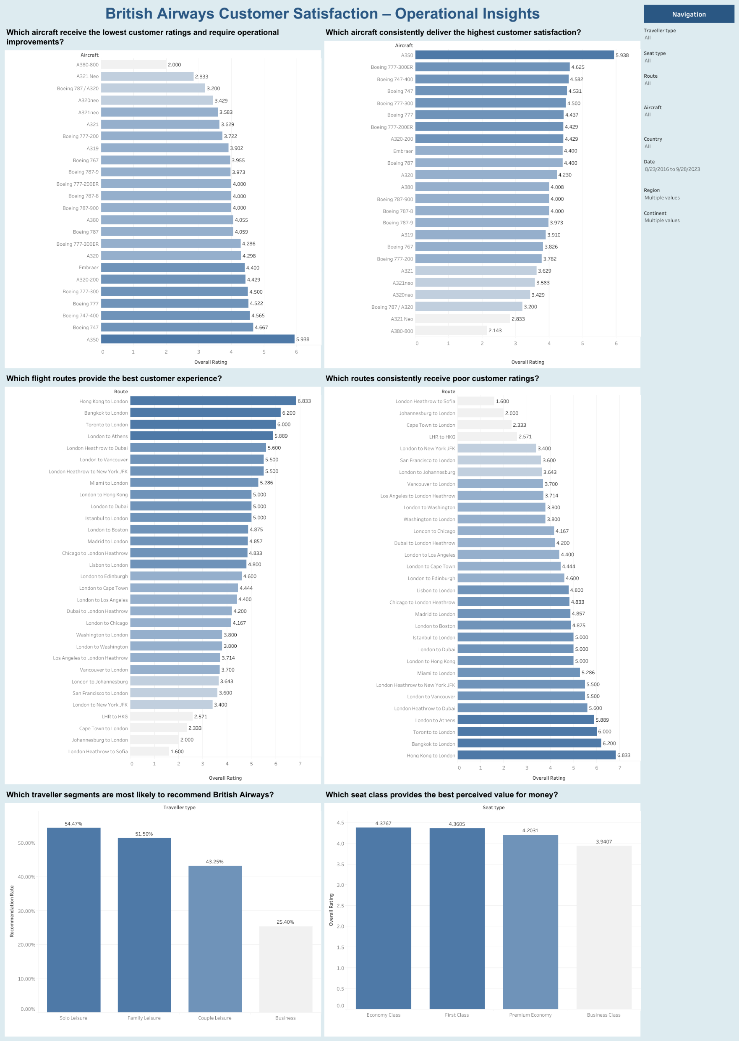
Operational Insights Dashboard

Slide 12
Operational Business Questions and Insights
Which aircraft receive the lowest customer ratings and require operational improvements ?
A. The A380-800 has the lowest customer satisfaction score (approximately 2/10), making it the highest priority for operational review.
A321 Neo, Boeing 787 / A320 and A320 Neo also receive comparatively low ratings, suggesting recurring customer experience issues.
2. Which aircraft consistently deliver the highest customer satisfaction?
A. The A350 receives the highest average customer satisfaction rating (5.94/10) among aircraft with sufficient customer feedback, indicating a consistently positive passenger experience. Boeing 777-300ER and Boeing 747-400 also perform well, suggesting these aircraft deliver a strong overall travel experience. These aircraft can serve as benchmarks for improving service quality across the rest of the fleet.
3. Which flight routes provide the best customer experience ?
A. The analysis indicates that Hong Kong–London, Bangkok–London, and Toronto–London deliver the best customer experience, achieving the highest average overall ratings of 6.83, 6.20, and 6.00, respectively. These routes consistently receive positive customer feedback, reflecting strong service quality and passenger satisfaction.
4. Which routes consistently receive poor customer ratings?
The analysis shows that London Heathrow–Sofia, Johannesburg–London, Cape Town–London, and LHR–HKG receive the lowest customer satisfaction scores, with average ratings of 1.60, 2.00, 2.33, and 2.57, respectively. These routes consistently underperform compared to others.
5. Which traveller segments are most likely to recommend British Airways?
A. Among all traveller segments, Solo Leisure passengers are the most likely to recommend British Airways, with a recommendation rate of 54.47%. This is followed by Family Leisure (51.50%), Couple Leisure (43.25%), and Business travellers (25.40%).
6. Which seat class provides the best perceived value for money ?
A. The analysis reveals that Economy Class offers the highest perceived value for money, with an average score of 4.38, followed closely by First Class (4.36), Premium Economy (4.20), and Business Class (3.94).

Slide 13
Business Impact
1. Improve Customer Satisfaction and Brand Reputation
The analysis identifies the factors that have the strongest influence on passengers' overall ratings. By focusing on improving underperforming services such as entertainment, food, ground service, or value for money (where applicable), British Airways can increase customer satisfaction and strengthen its premium brand image.
Business Value
Higher customer satisfaction
Better online reviews
Increased recommendation rate
Improved brand reputation
2. Prioritize Investments Based on Customer Feedback
Instead of investing equally across all services, the dashboards help management identify which service categories contribute most to positive or negative customer experiences.
Cabin Staff Service consistently receives high ratings.
Certain operational areas receive comparatively lower ratings.
This allows decision-makers to prioritize investments where they will have the greatest customer impact rather than spending resources uniformly.
Business Value
Better ROI on operational investments
Data-driven budgeting
Reduced unnecessary spending

Slide 14
3. Improve Route-Level Performance
The Route Analysis highlights routes that consistently receive poor customer ratings.
London Heathrow – Sofia
Johannesburg – London
Cape Town – London
London Heathrow – Hong Kong
Management can investigate these routes to determine whether issues are related to:
flight delays
aircraft quality
staffing
catering
airport handling
route-specific operational challenges
Similarly, highly rated routes can be studied to identify best practices that can be replicated elsewhere.
Business Value
Higher route profitability
Better passenger experience
Standardized service quality
4. Optimize Aircraft Utilization
The Aircraft Analysis identifies which aircraft types consistently provide better customer experiences.
Higher-rated aircraft may indicate:
better cabin condition
improved seating comfort
newer interiors
Lower maintenance issues
Lower-rated aircraft can be prioritized for:
refurbishment
maintenance
replacement planning
Business Value
Better fleet planning
Higher customer comfort
Improved asset utilization

Slide 15
5. Enhance Customer Experience Across Passenger Segments
The Passenger Analysis compares customer satisfaction across:
Traveller Type
Seat Type
Country
Route
This helps British Airways understand whether:
Business travellers
Leisure travellers
Economy passengers
Business Class passengers have different expectations.
Marketing and service improvements can then be tailored for each passenger segment.
Business Value
Personalized customer experience
Better customer retention
Increased loyalty
6. Improve Operational Decision-Making
The Operational Insights Dashboard enables managers to monitor customer satisfaction across multiple operational dimensions in a single view.
Managers can quickly identify:
declining service quality
underperforming routes
poorly rated aircraft
country-specific trends
This reduces manual reporting and enables faster, evidence-based operational decisions.
Business Value
Faster issue identification
Reduced reporting time
Improved operational efficiency

Slide 16
7. Increase Customer Retention
Satisfied passengers are more likely to:
fly again
Recommend British Airways
join loyalty programs
By improving the drivers of customer satisfaction identified in this analysis, British Airways can reduce customer churn.
Business Value
Higher repeat bookings
Stronger customer loyalty
Increased lifetime customer value
8. Support Strategic Planning
Senior management can use the Executive Dashboard to monitor:
Overall Rating
Recommendation Rate
Review Volume
Customer Satisfaction Trends
These KPIs help leadership evaluate whether service improvement initiatives are delivering measurable results over time
.
Business Value
Executive-level visibility
Performance monitoring
Long-term strategic planning

Slide 17
Business Recommendations
1. Focus on Low-Rated Routes
Investigate routes with consistently poor customer ratings by conducting route-specific operational reviews. Analyze delays, staffing levels, aircraft allocation, catering quality, and airport handling services to identify root causes and implement targeted improvements.
2. Upgrade Lower-Rated Aircraft
Aircraft that consistently receive lower customer ratings should be prioritized for maintenance, cabin refurbishment, seating upgrades, and in-flight entertainment improvements to enhance passenger comfort.
3. Improve Underperforming Service Categories
Allocate resources toward improving service categories with comparatively lower ratings, such as entertainment, Wi-Fi, food quality, or ground service. Continuous monitoring should be implemented to measure the effectiveness of these improvements.
4. Replicate Best Practices
Study the operational practices of top-performing routes, aircraft, and service teams. Standardize successful processes and training programs across lower-performing operations to improve consistency.
5. Use Customer Feedback for Continuous Improvement
Implement a continuous feedback monitoring process using customer reviews to detect emerging issues early. Regular dashboard reviews can help management respond proactively rather than reactively.
6. Segment Customer Experience Strategies
Develop tailored service strategies for different traveller types and cabin classes. Understanding the unique expectations of business, leisure, economy, and premium passengers enables more personalized service delivery.
7. Monitor KPIs Regularly
Track key performance indicators such as Overall Rating, Recommendation Rate, Service Ratings, and Route Performance on a monthly basis. Establish performance targets and trigger corrective actions when KPIs fall below acceptable thresholds.

Slide 18
8. Adopt Data-Driven Decision Making
Integrate these dashboards into regular management reviews so that operational and strategic decisions are based on customer insights rather than assumptions. This supports continuous improvement and more effective resource allocation.
Overall Project Conclusion
The British Airways Customer Satisfaction Analysis demonstrates how customer review data can be transformed into actionable business insights. By analyzing service quality, passenger segments, aircraft performance, and route-level satisfaction, the dashboards enable stakeholders to identify strengths, uncover improvement opportunities, and prioritize operational initiatives. Implementing the recommendations from this analysis can help British Airways enhance customer satisfaction, improve operational efficiency, strengthen customer loyalty, and support data-driven strategic decision-making.

